Slide 1
CRM SALES FORCE
REPORT ANALYSIS

Slide 2
INTRODUCTION
Salesforce is a cloud-based Customer Relationship Management (CRM) platform that enables businesses to manage customer data, sales operations, and marketing campaigns. It provides various features, and tools businesses can use to improve customer relationships, including customer segmentation, customer data management, and customer support. Salesforce also offers a variety of integrations with third-party applications and services, making it a powerful and versatile CRM platform.

Slide 3




TOOLS USED
EXCEL
MY SQL
TABLEAU
POWER BI

Slide 4
Group 6
Atharva
Badal
Rupesh
Samranuddin
Sonu
Shivangi

Slide 5
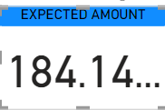
KPI 1
EXPECTED AMOUNT

Slide 6
KPI
ACTIVE OPPORTUNITIES
ACTIVE OPPORTUNITIES
1272
CONVERSION RATE
Conversion Rate
10.33%
WIN RATE
31.06%
WIN RATE

Slide 7
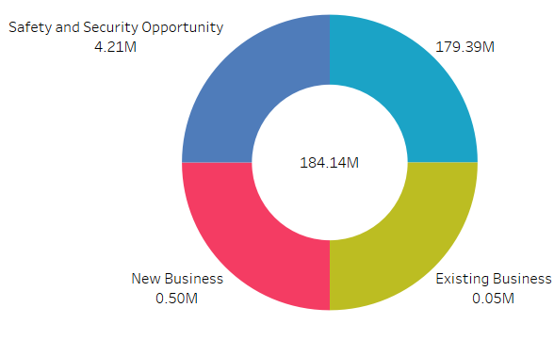
KPI
LOSS
EXPECTED AMOUNT BY
OPPORTUNITY TYPE
LOSS
1.93K

Slide 8
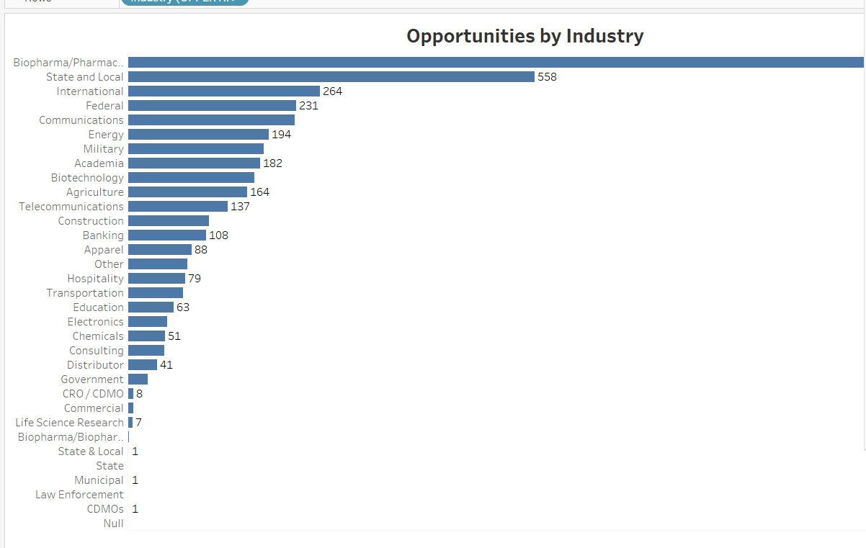
KPI
OPPORTUNITIES BY INDUSTRY

Slide 9
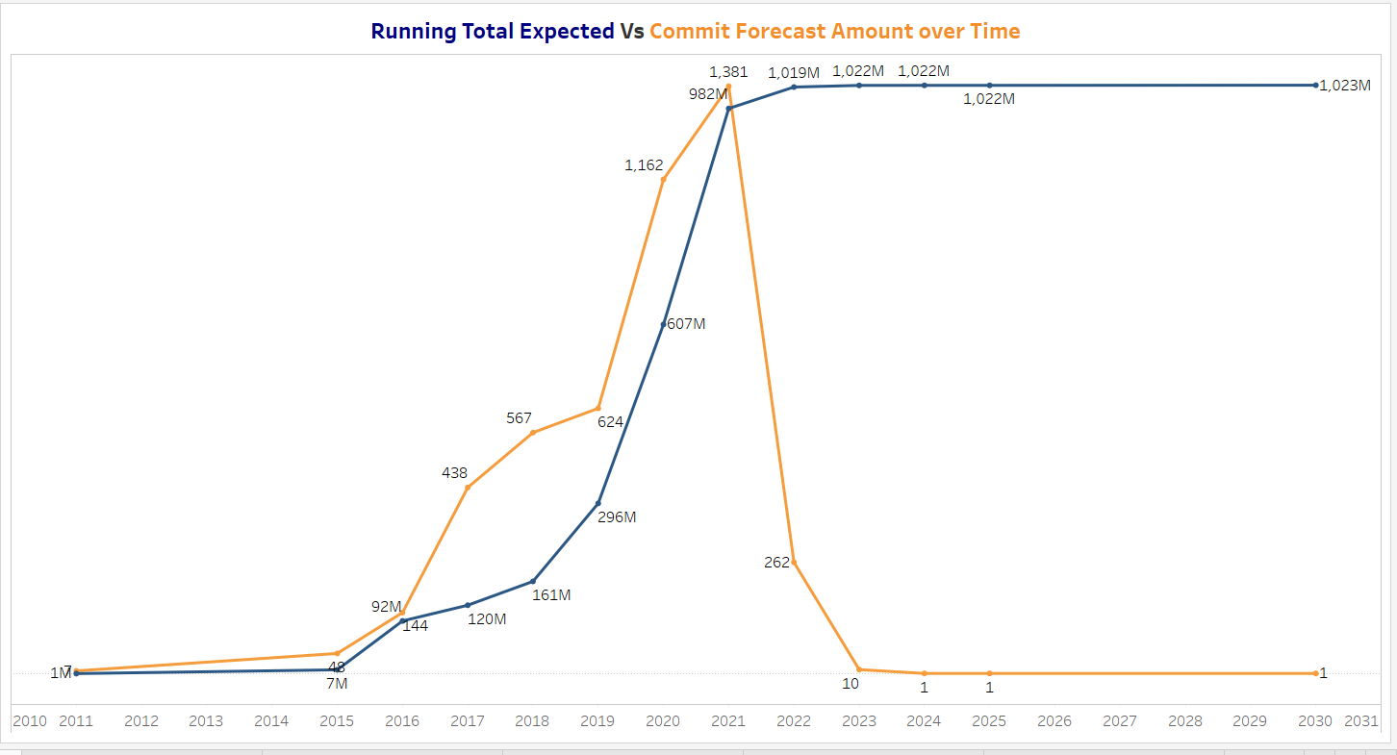
TREND ANALYSIS
Running Total Expected VS Commit Forecast Amount over time

Slide 10
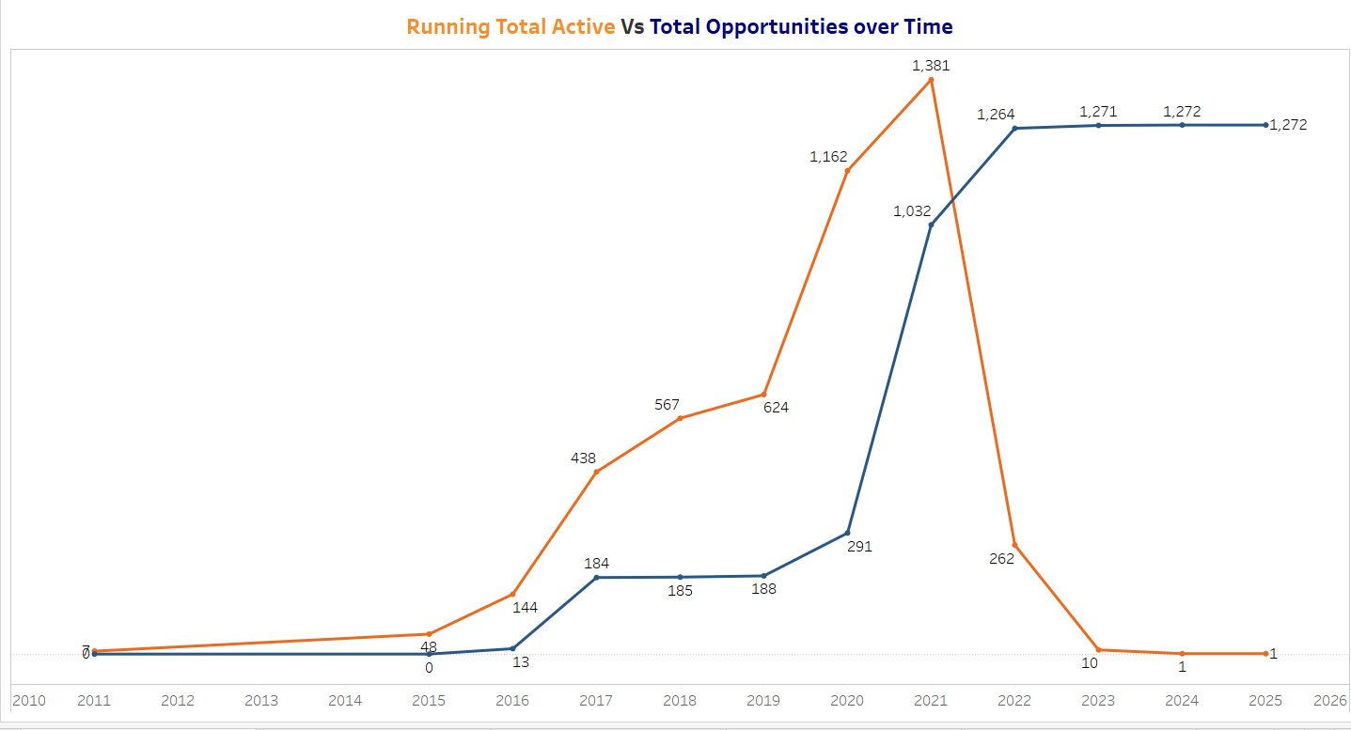
Running Total Active Vs Total Opportunities Over Time

Slide 11
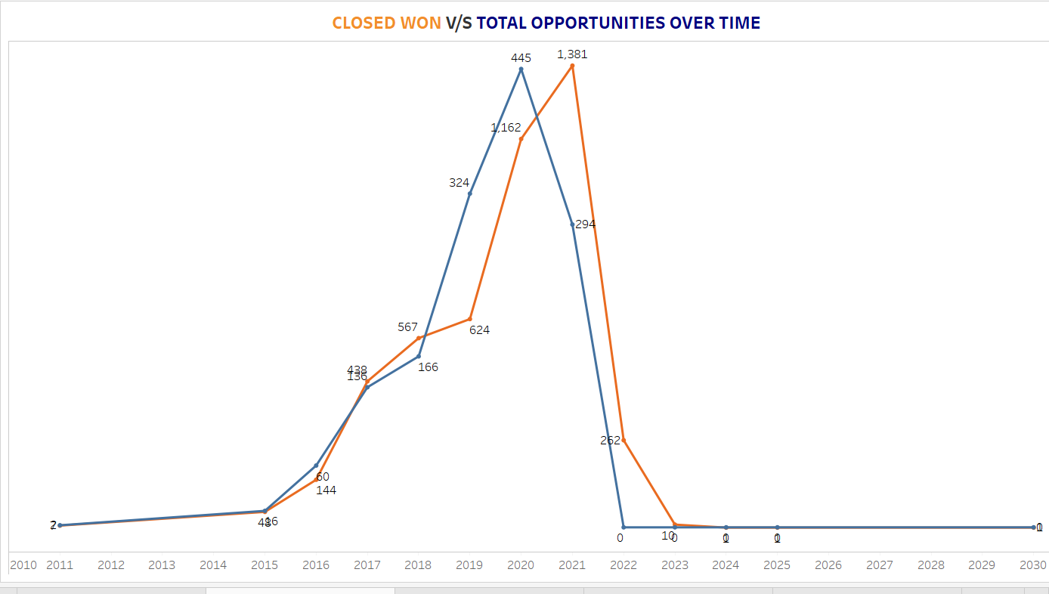
Closed Won Vs Total Opportunities Over Time

Slide 12
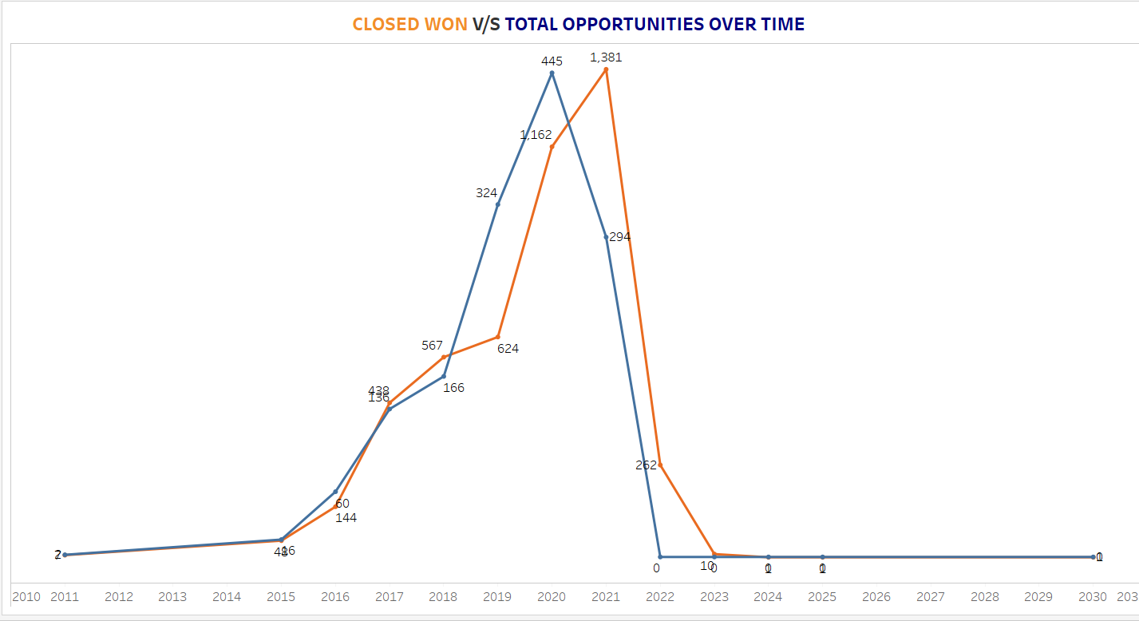
Closed Won Vs Total Closed Over Time

Slide 13
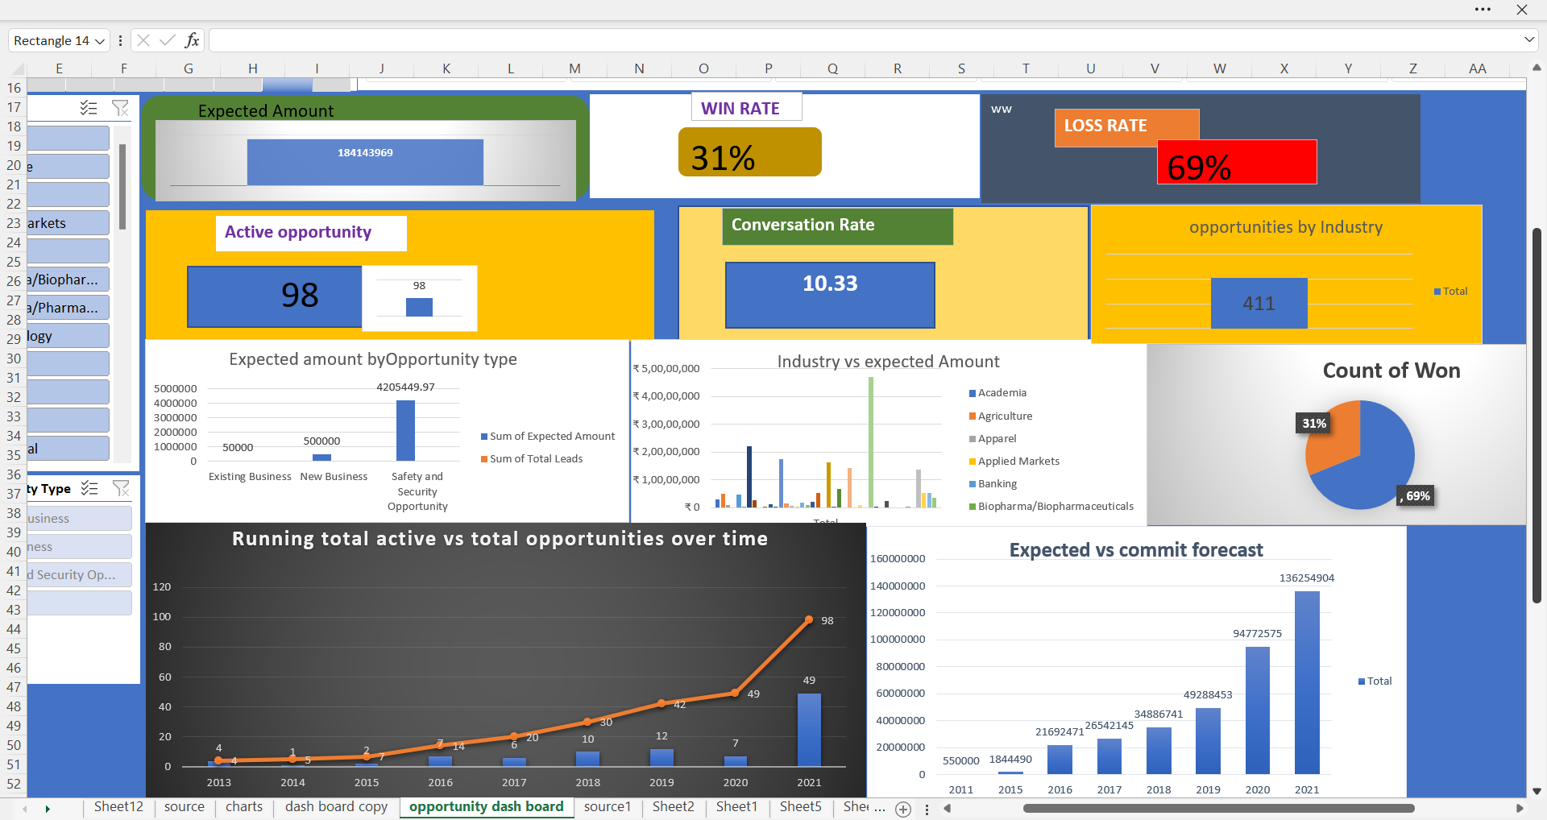
OPPORTUNITY DASH BOARD EXCEL

Slide 14
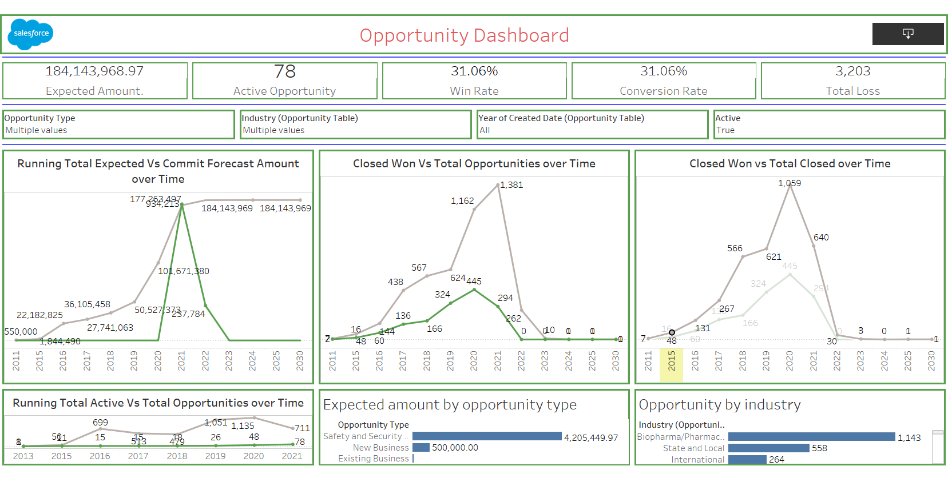
OPPORTUNITY DASH BOARD TABLEAU

Slide 15
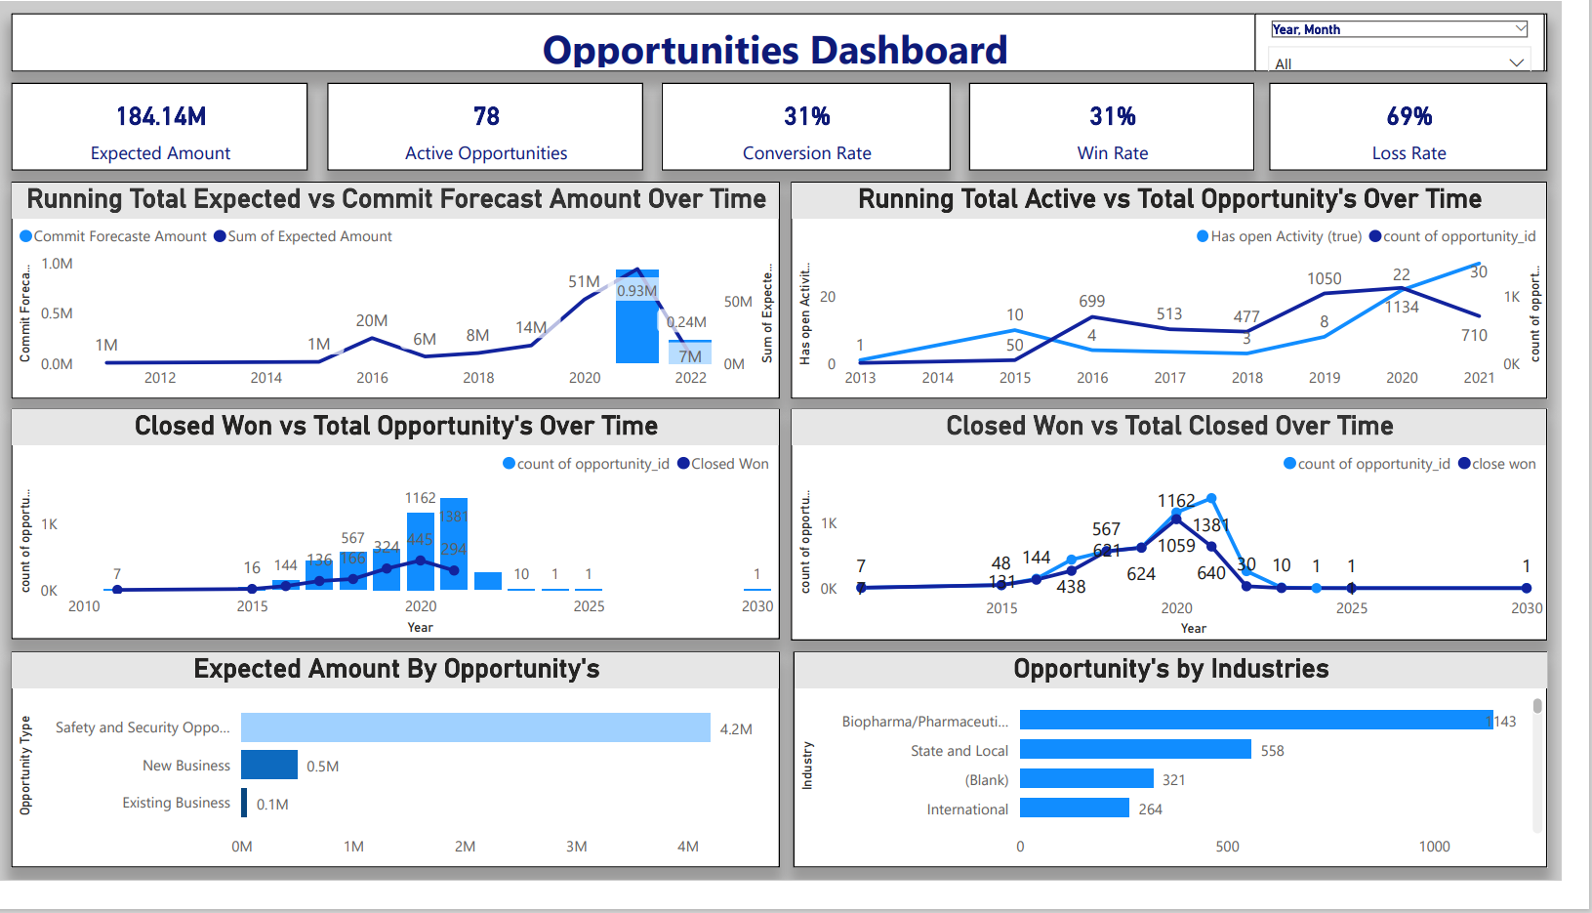
OPPORTUNITY DASH BOARD POWER BI

Slide 16
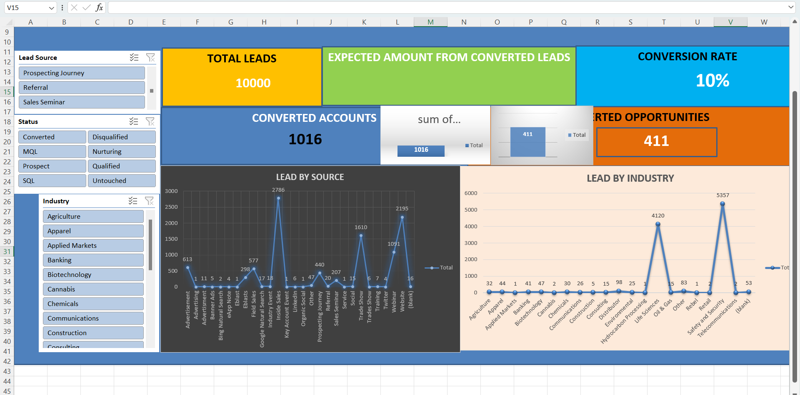
LEAD DASH BOARD EXCEL

Slide 17
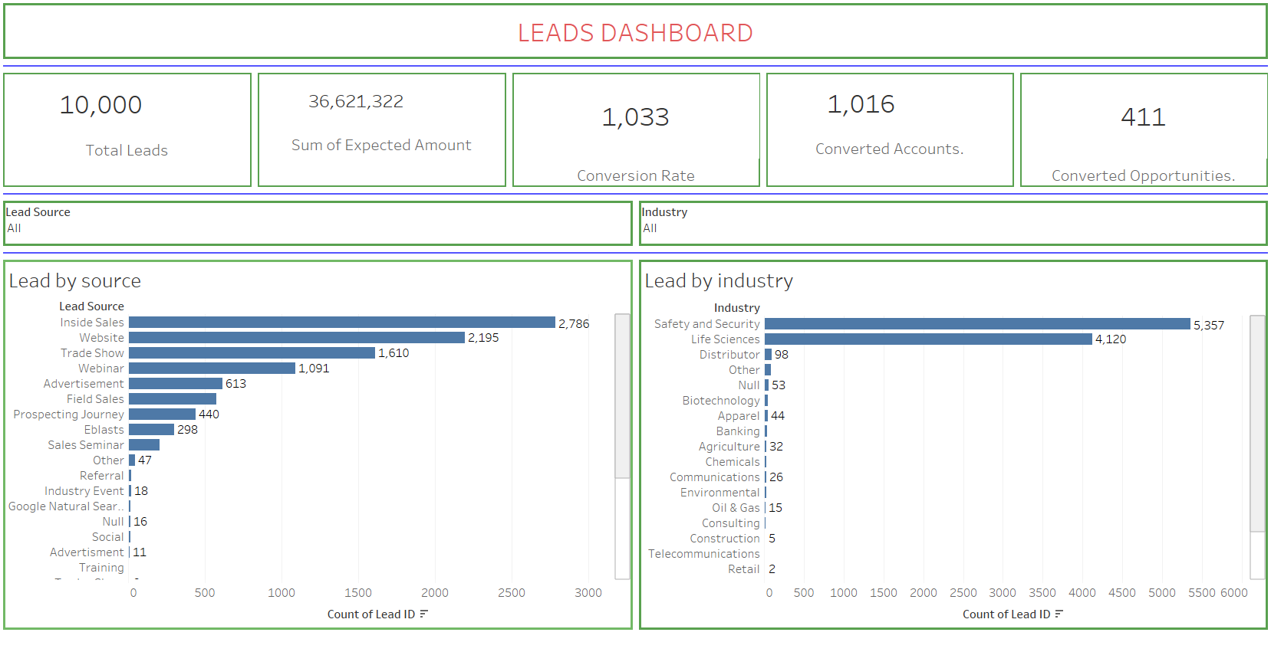
LEAD DASH BOARD TABLEAU

Slide 18
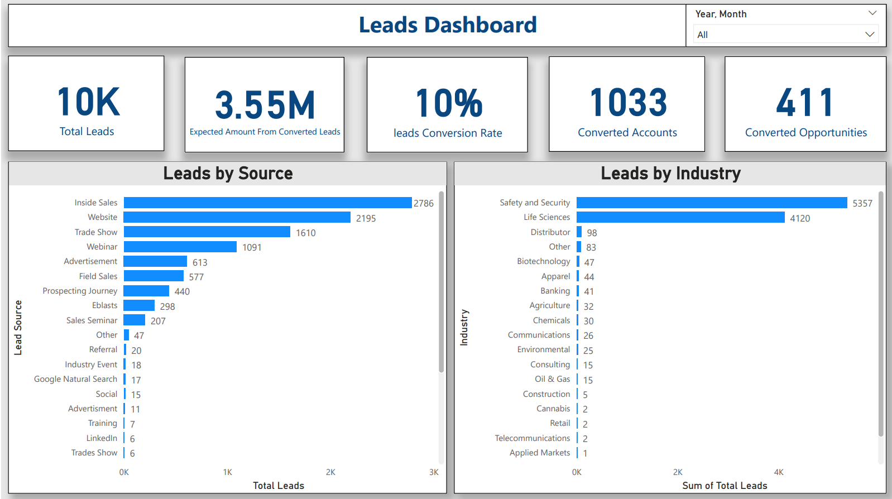
LEAD DASH BOARD POWER BI

Slide 19
CONCLUSION
Created Dash Board on opportunity table and Lead table
Created reports based on my knowledge using excel ,BI tools Tableau and power bi
I would like to thank my team members and
Mentor-Mahendra for guidance and support.

Slide 20
THANK YOU

